Slide 1
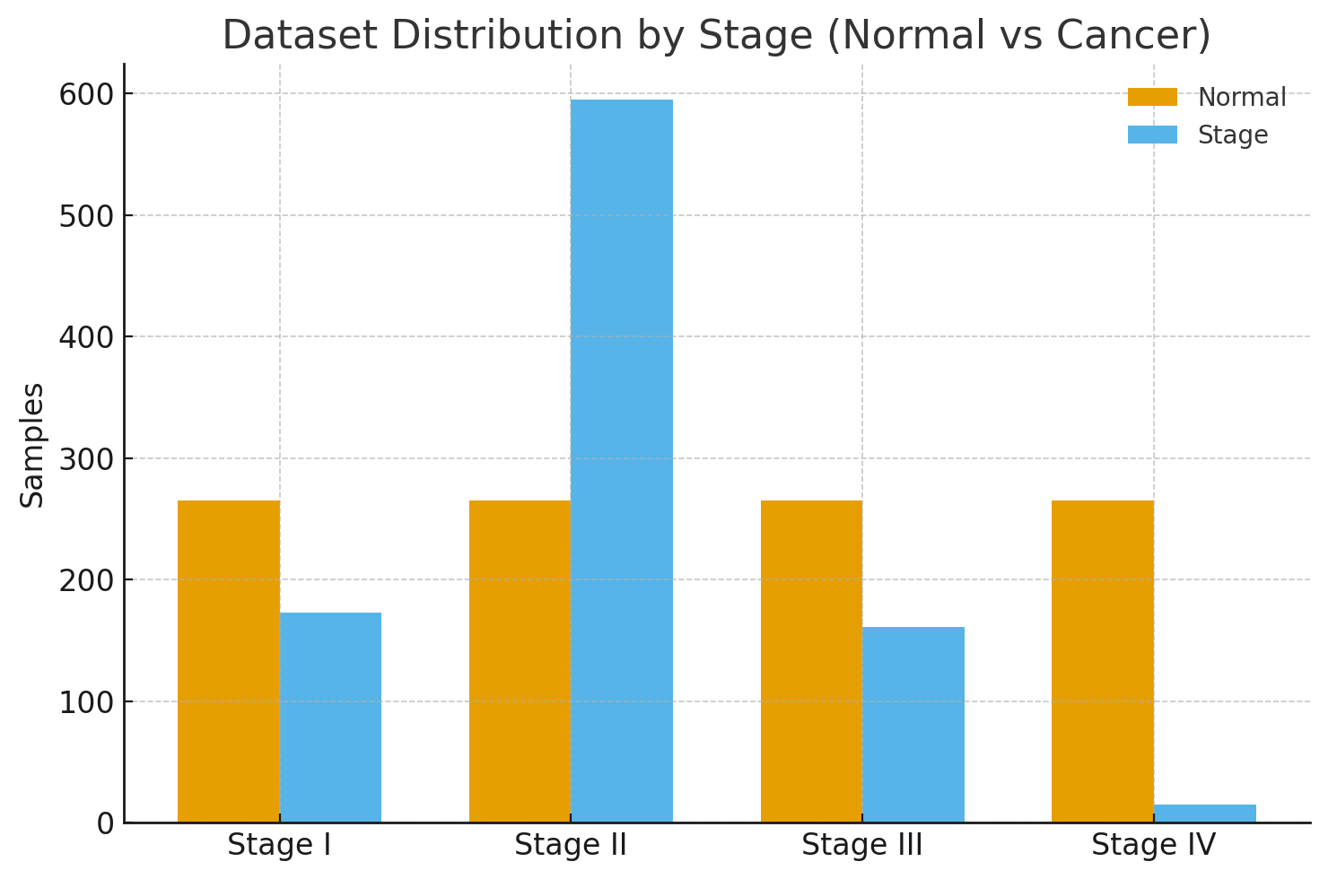
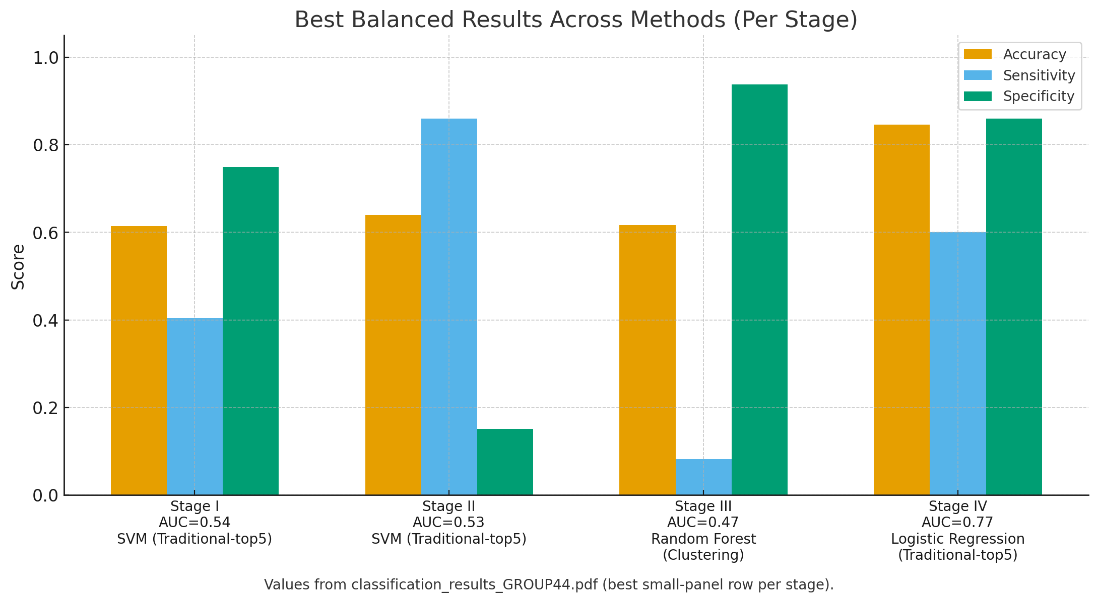
Breast Cancer Stage Classification with miRNA
Team Members
Faculty Course Facilitator
Joshua Adegboyo Anika Baro Villa Nicholas Campos Brehon Parker
Dr. Hanqi Zhuang
Dr. Rabia Shahid
EGN 4952C
Electrical Engineering & Computer Science
Project Advisor
#8
Sponsored by: Dr. Ali Ibrahim
Dr. Ali Ibrahim
Problem Statement
Breast cancer staging relies on tissue biopsies and pathology. Integrating miRNA profiles could improve diagnostic accuracy without further invasive procedures. Yet high dimensionality (1,881 features), limited sample sizes, and inconsistent feature-selection outputs hinder reliable biomarker discovery. This project compares traditional, deep learning, and clustering approaches to derive stage-specific miRNA panels and assess accuracy and interpretability under imbalance and heterogeneity.
Results
Traditional selection gave the most stable performance with compact 5–15 miRNA panels at our data scale (1,881 features and 1,209 samples). Under our evaluation (single split for Stages I–III and stratified K-fold CV for Stage IV with 15 positives), the best balanced results across methods were 61.4% (Stage I), 64.0% (Stage II), 61.7% (Stage III, clustering; low sensitivity), and 84.6% for Stage IV (AUC 0.767; sensitivity 60.0%). Deep learning rarely outperformed traditional, and clustering sometimes matched accuracy but often traded off sensitivity and specificity.
Conclusions & Impact
No single method is optimal; different selectors capture complementary signals.
Traditional feature selection methods offer most balanced performance for small-sample miRNA studies.
Class imbalance and stage heterogeneity strongly affect performance.
Our comparative pipeline is reusable for other cancers and biomarker studies.

